Slide 1
Sequential Games and Adversarial Search
CHAPTER 5
CMPT 310
Introduction to Artificial Intelligence
Simon Fraser University
Oliver Schulte
Notes:
After Chapter 3b.

Slide 2
Environment Type Discussed In this Lecture
Fully Observable
Turn-taking: Semi-dynamic
Deterministic and non-deterministic
yes
Multi-agent
yes
Sequential
yes
no
Discrete
no
yes
Discrete
yes
Game Tree Search
Game Matrices
Continuous Action Games
Notes:
Discuss discrete variables a little bit.

Slide 3
Sequential Games

Slide 4
Game Trees: Definition
Every node is assigned to a player (turn).
For every possible action of the player of the node, there is a child.
The edge node ➔child is labelled with the action.
The leaves of the tree specify the payoff for each player.

Slide 5
Hume’s Farmer Problem
1
H
Not H
2
not H1
2
Not H2
H1
H2
2 2
0 3
3 0
1 1
The payoffs for player 1 are listed at the top.
Backward Induction: Look ahead and reason back.

Slide 6
The Story
Two farmers need help with their harvest.
Farmer 2 harvests before Farmer 1 .
If Farmer 1 asks Farmer 2 for help and receives it, Farmer 1 prefers not to reciprocate.
If Farmer 1 does not reciprocate, Farmer 2 prefers not helping over helping.
Both would rather help each other than harvest alone.
Notes:
Real-life example of trust issues: Ebay selling and buying. On-line in general.

Slide 7
Trust on E-Bay
Seller
Send Item
Not Send Item
2
send payment
2
not send payment
send payment
not send payment
2 2
0 3
3 0
1 1

Slide 8
Zero-Sum Sequential Games
AdversaRIAL Search

Slide 9
Adversarial Search
Examine the problems that arise when we try to plan ahead in a world where other agents are planning against us.
A good example is in board games.
Adversarial games, while much studied in AI, are a small part of game theory in economics.

Slide 10
Typical AI assumptions
Two agents whose actions alternate
Utility values for each agent are the opposite of the other
creates the adversarial situation
Fully observable environments
In game theory terms: Zero-sum games of perfect information.

Slide 11
Search versus Games
Search – no adversary
Solution is (heuristic) method for finding goal
Heuristic techniques can find optimal solution
Evaluation function: estimate of cost from start to goal through given node
Examples: path planning, scheduling activities
Games – adversary
Solution is strategy (strategy specifies move for every possible opponent reply).
Optimality depends on opponent. Why?
Time limits force an approximate solution
Evaluation function: evaluate “goodness” of game position
Examples: chess, checkers, Othello, backgammon

Slide 12
Types of Games
 | deterministic | Chance moves
Perfect information | Chess, checkers, go, othello | Backgammon, monopoly
Imperfect information (Initial Chance Moves) | Bridge, Skat | Poker, scrabble, blackjack
on-line backgammon
on-line chess
Notes:
http://www.247backgammon.org/
If Nature is not a player, then poker etc. involve chance moves like drawing cards, tiles. The other card games involve no more chance. Play with class.
Theorem of Nobel Laureate Harsanyi: Every game with chance moves during the game has an equivalent representation with initial chance moves only.
A deep result, but computationally it is more tractable to consider chance moves as the game goes along.
This is basically the same as the issue of full observability + nondeterminism vs. partial observability + determinism.

Slide 13
Zero-Sum Games of Perfect Information

Slide 14
Game Setup
Two players: MAX and MIN
MAX moves first and they take turns until the game is over
Winner gets award, loser gets penalty.
Games as search:
Initial state: e.g. board configuration of chess
Successor function: list of (move,state) pairs specifying legal moves.
Terminal test: Is the game finished?
Utility function: Gives numerical value of terminal states. E.g. win (+1), lose (-1) and draw (0) in tic-tac-toe or chess
Notes:
Explain these conventions carefully. Maybe contrast with general game trees.

Slide 15
Size of search trees
b = branching factor
d = number of moves by both players
Search tree is O(b^{d})
Chess
b ~ 35
D ~100
- search tree is ~ 10 ¹⁵⁴ (!!)
- completely impractical to search this
Game-playing emphasizes being able to make optimal decisions in a finite amount of time
Somewhat realistic as a model of a real-world agent
Even if games themselves are artificial
Notes:
search tree takes into account legal moves

Slide 16
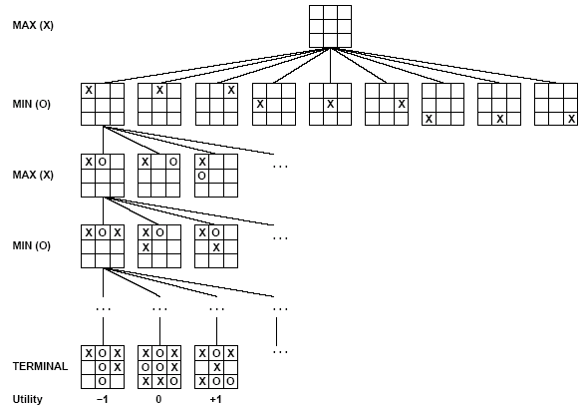
Partial Game Tree for Tic-Tac-Toe

Slide 17
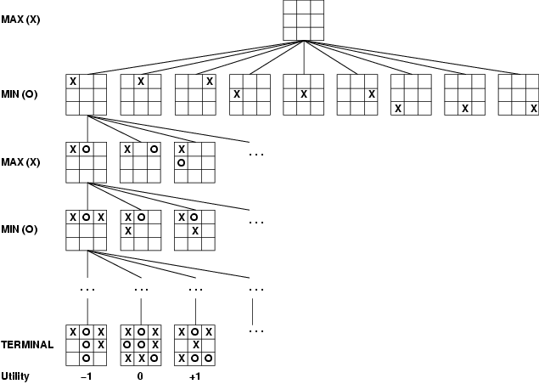
Game tree (2-player, deterministic, turns)
How do we search this tree to find the optimal move?
Notes:
Add tic-tac-toe demo.

Slide 18
Minimax Search

Slide 19
Minimax strategy: Look ahead and reason backwards
Find the optimal strategy for MAX assuming an infallible MIN opponent
Need to compute this all the down the tree
Game Tree Search Demo
Assumption: Both players play optimally!
Given a game tree, the optimal strategy can be determined by using the minimax value of each node.
Zermelo 1912.
Notes:
https://www.yosenspace.com/posts/computer-science-game-trees.html

Slide 20
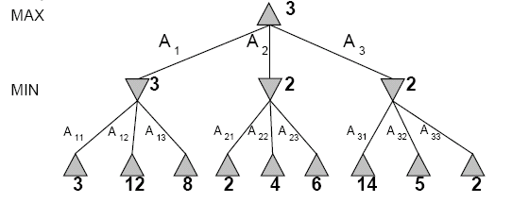
Two-Ply Game Tree
Notes:
Chocolate playing: max gets x number of chocolates, min has to give up x number of chocolates.

Slide 21
Two-Ply Game Tree

Slide 22
Two-Ply Game Tree
Notes:
Ply = 2 half moves

Slide 23
Two-Ply Game Tree
Minimax maximizes the utility for the worst-case outcome for max
The minimax decision

Slide 24
What if MIN does not play optimally?
Definition of optimal play for MAX assumes MIN plays optimally:
maximizes worst-case outcome for MAX
But if MIN does not play optimally, MAX will do even better
Can prove this (Problem 6.2)

Slide 25
Pseudocode for Minimax Algorithm
function MINIMAX-DECISION(state) returns an action
inputs: state, current state in game
v←MAX-VALUE(state)
return the action in SUCCESSORS(state) with value v
function MAX-VALUE(state) returns a utility value
if TERMINAL-TEST(state) then return UTILITY(state)
v ← -∞
for a,s in SUCCESSORS(state) do
v ← MAX(v,MIN-VALUE(s))
return v
function MIN-VALUE(state) returns a utility value
if TERMINAL-TEST(state) then return UTILITY(state)
^{v ← ∞}
for a,s in SUCCESSORS(state) do
^{v ← MIN(v,MAX-VALUE(s))}
^{return v}

Slide 26
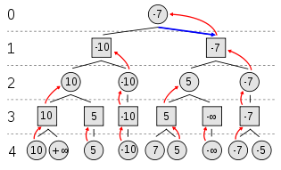
Example of Algorithm Execution
MAX to move
Notes:
Can have negative values too

Slide 27
Minimax Algorithm
Complete depth-first exploration of the game tree
Assumptions:
Max depth = d, b legal moves at each point
E.g., Chess: d ~ 100, b ~35
Criterion | Minimax
Time | O(b^{d})
Space | O(bd)
☹
☺

Slide 28
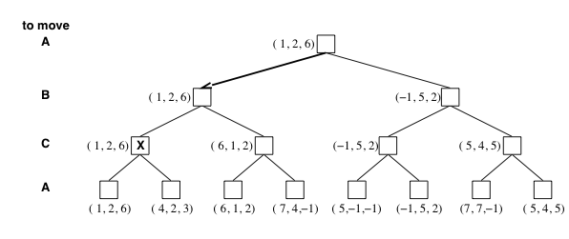
Multiplayer games
Games allow more than two players
Single minimax values become vectors

Slide 29
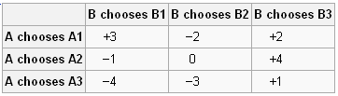
Example
Zero sum games: zero-sum describes a situation in which a participant's
gain or loss is exactly balanced by the losses or gains of the other participant(s).
If the total gains of the participants are added up, and the total losses are subtracted, they will sum to zero
A and B make simultaneous moves, illustrates minimax solutions.
Can they do better than minimax?
Can we make the space less complex?
Pure strategy vs mix strategies

Slide 30
Aspects of multiplayer games
Previous slide (standard minimax analysis) assumes that each player operates to maximize only their own utility
In practice, players make alliances
E.g, C strong, A and B both weak
May be best for A and B to attack C rather than each other
If game is not zero-sum (i.e., utility(A) = - utility(B) then alliances can be useful even with 2 players
e.g., both cooperate to maximum the sum of the utilities

Slide 31
Alpha-Beta Pruning

Slide 32
Practical problem with minimax search
Number of game states is exponential in the number of moves.
Solution: Do not examine every node
=> pruning
Remove branches that do not influence final decision
Alpha-beta pruning: for each node, estimate interval of possible values in corresponding subtree.
Alpha: current bound on what max can guarantee himself
Beta: current bound on what min can guarantee herself
Notes:
intuition: these pass information about best bounds in subtree

Slide 33
Alpha-beta Algorithm
Depth first search – only considers nodes along a single path at any time
α = highest-value that we can guarantee for MAX so far in the current path.
β = lowest-value that we can guarantee for MIN so far in the current path.
update values of α and β during search and prunes remaining branches as soon as the value is known to be worse than the current α or β value for MAX or MIN.
Alpha-beta Demo.
Notes:
https://www.yosenspace.com/posts/computer-science-game-trees.html
uses 10 as infinity

Slide 34
Informal Description
For formal description see text Ch.5.
Suppose that node v belongs to player A (max/min)
If estimates for all children are available, the estimates for the node v become the estimates of the best child.
This is like minimax
If a child has a better A-estimate, update the A-estimate for v.
If the opponent’s estimate for a child node is worse for A than the A estimate for v, stop exploring the child node.
This is the pruning step.

Slide 35
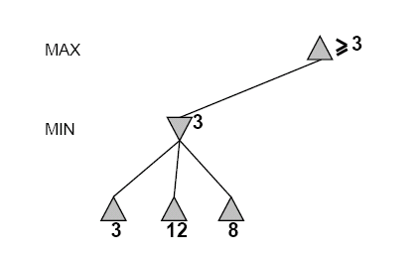
Alpha-Beta Example
Do DF-search until first leaf
Initial Range of possible values
[-∞,+∞]
[-∞, +∞]
Notes:
Intuition: if the game tree were to stop at this point, what do we know

Slide 36
Alpha-Beta Example: Update Min-Value
[-∞,+∞]
[-∞,3]
Child node has a better min-estimate
Notes:
Max can get at least 3

Slide 37
Alpha-Beta Example: Update Max Value
Child node has a better max-estimate
[3,+∞]
[3,3]
All children explored
Update max-estimate

Slide 38
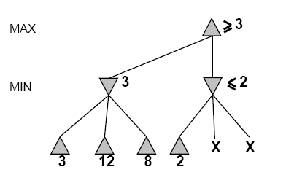
Alpha-Beta Example: Pruning
Child min-estimate is lower than max-estimate
[3,+∞]
[3,3]
[-∞,2]
Child node has a
better min-estimate
Notes:
update min estimate in subtree
notice that min estimate is lower than max estimate above
stop exploring subtree

Slide 39
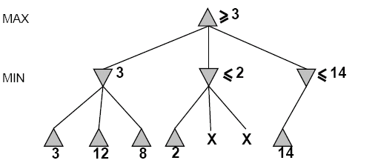
Alpha-Beta Example: Update Min Value
,
we have bounds on all successors
[3,14]
[3,3]
[-∞,2]
[-∞,14]
Child node has a better min-estimate

Slide 40
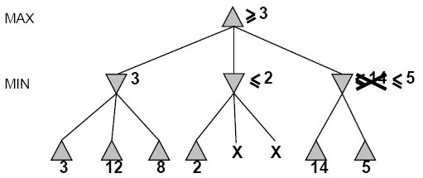

Alpha-Beta Example: Update Min Value
[3,5]
,
[3,3]
[−∞,2]
[-∞,5]
Child node has a better min-estimate
Notes:
Max can get at most 5

Slide 41
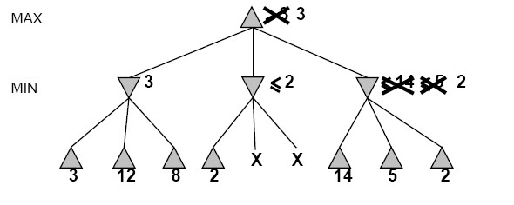
Alpha-Beta Example (continued)
All children explored
Update min-estimate
Child node has a better min-estimate
All children explored
Update max-estimate
[3,3]
[3,3]
[−∞,2]
[2,2]

Slide 42
Alpha-Beta Example (continued)
[3,3]
[3,3]
[-∞,2]
[2,2]

Slide 43
Exercise
-which nodes can be pruned?
MAX
MIN
MAX
3
5
6
4
1
2
7
8
Notes:
Nothing actually if ordered left-right.
If ordered right-left, can prune the 1-2 subtree.

Slide 44
Pseudocode for Alpha-Beta Algorithm
function ALPHA-BETA-SEARCH(state) returns an action
inputs: state, current state in game
v←MAX-VALUE(state, - ∞ , +∞)
return the action in SUCCESSORS(state) with value v

Slide 45
Pseudocode for Alpha-Beta Algorithm
function ALPHA-BETA-SEARCH(state) returns an action
inputs: state, current state in game
v←MAX-VALUE(state, - ∞ , +∞)
return the action in SUCCESSORS(state) with value v
function MAX-VALUE(state,α , β) returns a utility value
if TERMINAL-TEST(state) then return UTILITY(state)
v ← - ∞
for a,s in SUCCESSORS(state) do
v ← MAX(v,MIN-VALUE(s, α , β))
if v ≥ β then return v
α ← MAX(α ,v)
return v

Slide 46
Alpha-Beta Analysis

Slide 47
Effectiveness of Alpha-Beta Search
Worst-Case
branches are ordered so that no pruning takes place. In this case alpha-beta gives no improvement over exhaustive search
Best-Case
each player’s best move is the left-most alternative (i.e., evaluated first)
in practice, performance is closer to best rather than worst-case
In practice often get O(b^{(d/2)}) rather than O(b^{d})
this is the same as having a branching factor of √(b),
since (√b)^{d} = b^{(d/2)}
i.e., we have effectively gone from b to √b.
e.g., in chess go from b ~ 35 to b ~ 6
this permits much deeper search in the same amount of time
Typically twice as deep.
Notes:
b^(d x c) = (b^c)^d.
So b^(d/2) = (b^1/2)^d

Slide 48
Final Comments about Alpha-Beta Pruning
Pruning does not affect final results
Entire subtrees can be pruned.
Good move ordering improves effectiveness of pruning
Repeated states are again possible.
Store them in memory = transposition table

Slide 49
Game Playing Practice

Slide 50
Practical Implementation
How do we make these ideas practical in real game trees?
Standard approach:
evaluation function
cutoff test: where do we stop descending the tree
Return evaluation of best position when search is cut off.
Notes:
When the search is cut off, we evaluate the current state
by estimating its utility using an evaluation function.
depth limit
better: iterative deepening
cutoff only when no big changes are expected to occur next (quiescence search)
iterative deepening: stop when time runs out.

Slide 51
Static (Heuristic) Evaluation Functions
An Evaluation Function:
estimates how good the current board configuration is for a player.
Typically, one figures how good it is for the player, and how good it is for the opponent, and subtracts the opponents score from the players
Othello: Number of white pieces - Number of black pieces
Chess: Value of all white pieces - Value of all black pieces
Typical values from -infinity (loss) to +infinity (win) or [-1, +1].
If the board evaluation is X for a player, it’s -X for the opponent.
Many clever ideas about how to use the evaluation function.
e.g. null move heuristic: let opponent move twice.
Example:
Evaluating chess boards,
Checkers
Tic-tac-toe

Slide 52
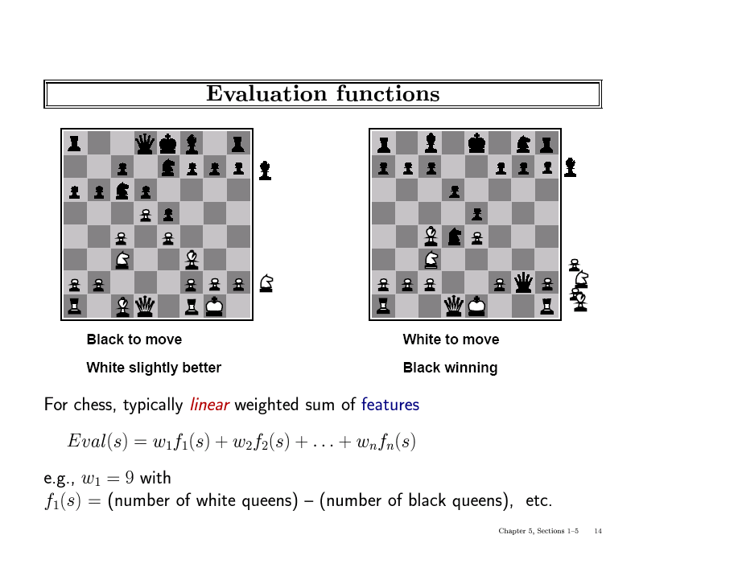

Slide 53
Learning Evaluation Functions
Exciting New Development: use neural net learning to learn evaluation functions from observed games (self-play)
Used in AlphaZero.
Then learned evaluation function represents the expected utility of a game state.
e.g. chance of winning the game
Expected utility estimate is used as heuristic in tree search.
Combines learning + search

Slide 54
Iterative (Progressive) Deepening
In real games, there is usually a time limit T on making a move.
How do we take this into account?
using alpha-beta we cannot use “partial” results with any confidence unless the full breadth of the tree has been searched
So, we could be conservative and set a conservative depth-limit which guarantees that we will find a move in time < T
disadvantage is that we may finish early, could do more search
In practice, iterative deepening search (IDS) is used
IDS runs depth-first search with an increasing depth-limit
when the clock runs out we use the solution found at the previous depth limit

Slide 55
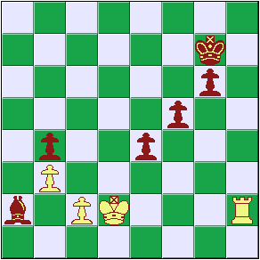
Heuristics and Game Tree Search
The Horizon Effect
sometimes there’s a major “effect” (such as a piece being captured) which is just “below” the depth to which the tree has been expanded the computer cannot see that this major event could happen it has a “limited horizon”
Notes:
Bishop is captured but computer cannot see this. Pawn sacrifices are good for the computer.

Slide 56
The State of Play
Checkers:
Chinook ended 40-year-reign of human world champion Marion Tinsley in 1994.
Chess:
Deep Blue defeated human world champion Garry Kasparov in a six-game match in 1997.
Othello:
human champions refuse to compete against computers: they are too good.
Go:
Alphago beat human world champion in 2017.
See (e.g.) http://www.cs.ualberta.ca/~games/ for more information

Slide 57
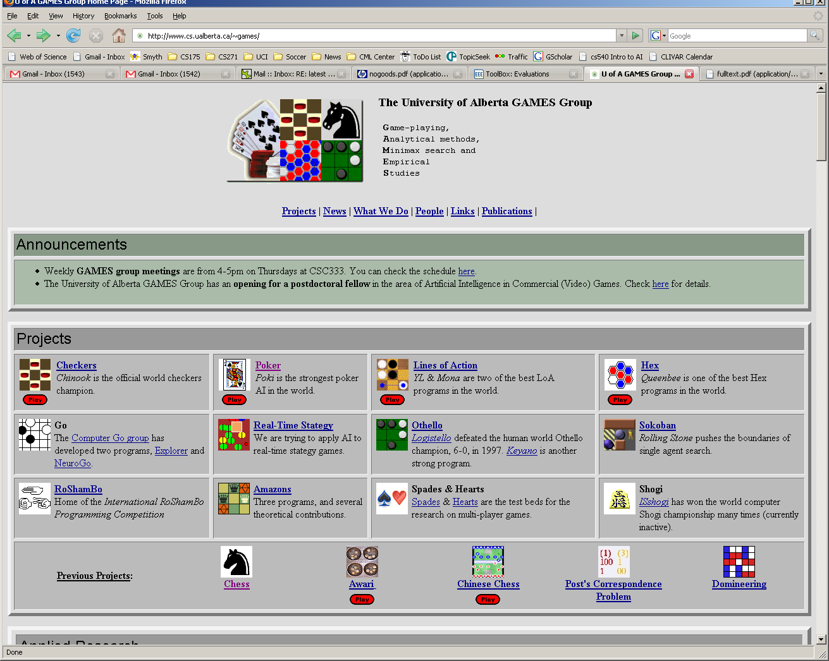

Slide 58
Deep Blue
1957: Herbert Simon
“within 10 years a computer will beat the world chess champion”
1997: Deep Blue beats Kasparov
Parallel machine with 30 processors for “software” and 480 VLSI processors for “hardware search”
Searched 126 million nodes per second on average
Generated up to 30 billion positions per move
Reached depth 14 routinely
Uses iterative-deepening alpha-beta search with transpositioning
Can explore beyond depth-limit for interesting moves

Slide 59
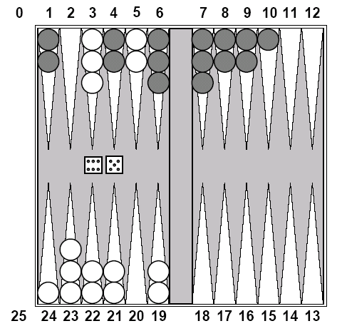
Chance Games.
Backgammon
your element of
chance

Slide 60
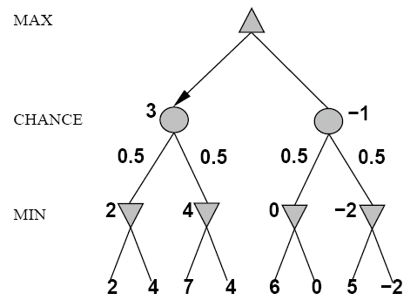
Expected Minimax
Interleave chance nodes
with min/max nodes
Again, the tree is constructed
bottom-up

Slide 61
Summary: Solving Games
 | Zero-sum | Non zero-sum
Perfect Information | Minimax, alpha-beta | Backward induction, retrograde analysis
Imperfect Information | Probabilistic minimax | Nash equilibrium
Notes:
Add something on retrograde analysis

Slide 62
Summary
Game playing can be effectively modeled as a search problem
Game trees represent alternate computer/opponent moves
Evaluation functions estimate the quality of a given board configuration for the Max player.
Minimax is a procedure which chooses moves by assuming that the opponent will always choose the move which is best for them
Alpha-Beta is a procedure which can prune large parts of the search tree and allow search to go deeper
For many well-known games, computer algorithms based on heuristic search match or out-perform human world experts.
Notes:
Add something on retrograde analysis

Slide 63
Single Agent vs. 2-Players
Every single agent problem can be considered as a special case of a 2-player game. How?
Make one of the players the Environment, with a constant utility function (e.g., always 0).
The Environment acts but does not care.
An adversarial Environment, with utility function the negative of agent’s utility.
In minimization, Environment’s utility is player’s costs.
Worst-Case Analysis.
E.g., program correctness: no matter what input user gives, program gives correct answer.
So agent design is a subfield of game theory.

Slide 64
Single Agent Design = Game Theory
Von Neumann-Morgenstern Games
Decision Theory = 2-player game, 1st player the “agent”, 2nd player “environment/nature”
(with constant or adversarial utility function)
From
General
To
Special
Case
Markov Decision Processes
Planning Problems
Notes:
Mention that problem of computing best reply = problem of optimal planning in game with nature.

Slide 65
Example: And-Or Trees
If an agent’s actions have nondeterministic effects, we can model worst-case analysis as a zero-sum game where the environment chooses the effects of an agent’s actions.
Minimax Search ≈ And-Or Search.
Example: The Erratic Vacuum Cleaner.
When applied to dirty square, vacuum cleans it and sometimes adjacent square too.
When applied to clean square, sometimes vacuum makes it dirty.
Reflex agent: same action for same location, dirt status.

Slide 66
And-Or Tree for the Erratic Vacuum
The agent “moves” at labelled OR nodes.
The environment “moves” at unlabelled AND nodes.
The agent wins if it reaches a goal state.
The environment “wins” if the agent goes into a loop.

Slide 67
Summary
Game Theory is a very general, highly developed framework for multi-agent interactions.
Deep results about equivalences of various environment types.
See Chapter 17 for more details.

